Slide 1


Hit Song Prediction with Spotify Acoustic Data
Team Members
  Debanjan Chowdhury
  Jagan Sirigiri
  Max Grody
Instructor: Dr. Ozgur Ozturk

Slide 2
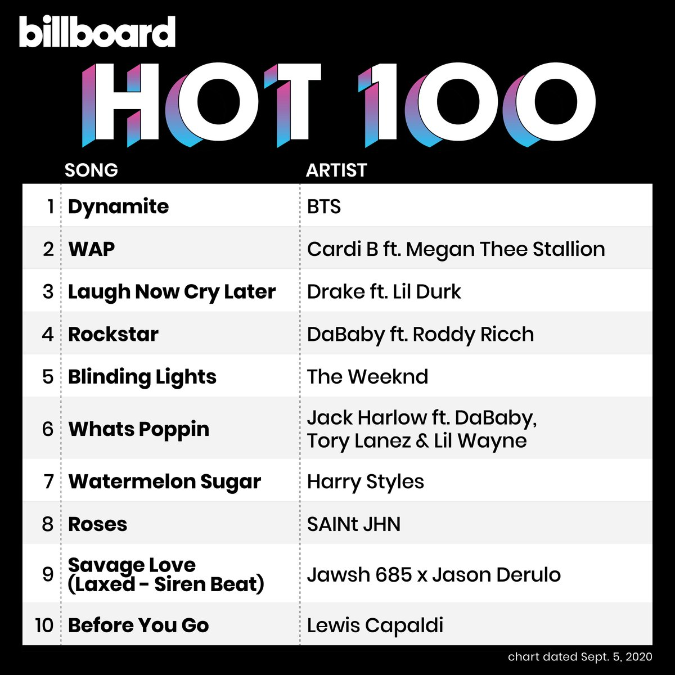
What is the project about?
Project Goal:
  Predict the ranking of songs that have appeared on the Billboard Hot 100
  Being able to predict the popularity of Billboard Hot 100 songs could provide insight into how musicians can adjust their craft to improve the odds of their song’s success
  Can we predict songs based on the features of the song (both audio and lyrical)?
  Unique research: using custom defined lyrical features with EchoNest features

Slide 3
Overview of Similar Approaches
Acoustic features influence musical choices across multiple genres
Acoustic features offer predictive value over random chance prediction of hit songs
Using acoustic features as inputs to ML models significantly improves model performance (hit classification with logistic regression)
High hit prediction accuracy using combination of acoustic features, lyrical features, and metadata
1.Acoustic Features Influence Musical Choices Across Multiple Genres
Authors: Michael D. Barone; Jotthi Bansal; Matthew H. Woolhouse
2. Music Popularity: Metrics, Characteristics, and Audio-Based Prediction
Authors: Junghyuk Lee; Jong-Seok Lee
3. Music intelligence: Granular data and prediction of top ten hit songs
Author: Seon Tae Kim; Joo Hee Oh
4. A Multimodal End-to-End Deep Learning Architecture for Music Popularity Prediction
Author: David Martín-gutiérrez ; Gustavo Hernández Peñaloza; Alberto Belmonte-hernández; Federico Álvarez García
Notes:
https://docs.google.com/document/d/1-2lZ5z5JKNZsNcbuMWlkSwW7bWE2l-kDr9nj_CuAllc/edit

Slide 4
Dataset
Acoustic and meta features of songs
  40,000+ rows of songs that have and have not made the Billboard Hot 100
  Data includes Spotify Echonest acoustic features
    Danceability
    Energy
    Key
    Loudness
    Mode
    Speechiness
    Acousticness
    Instrumentalness
    Liveness
    Valence
    Tempo
  Target Variable (1 for hit, 0 for not)

Slide 5
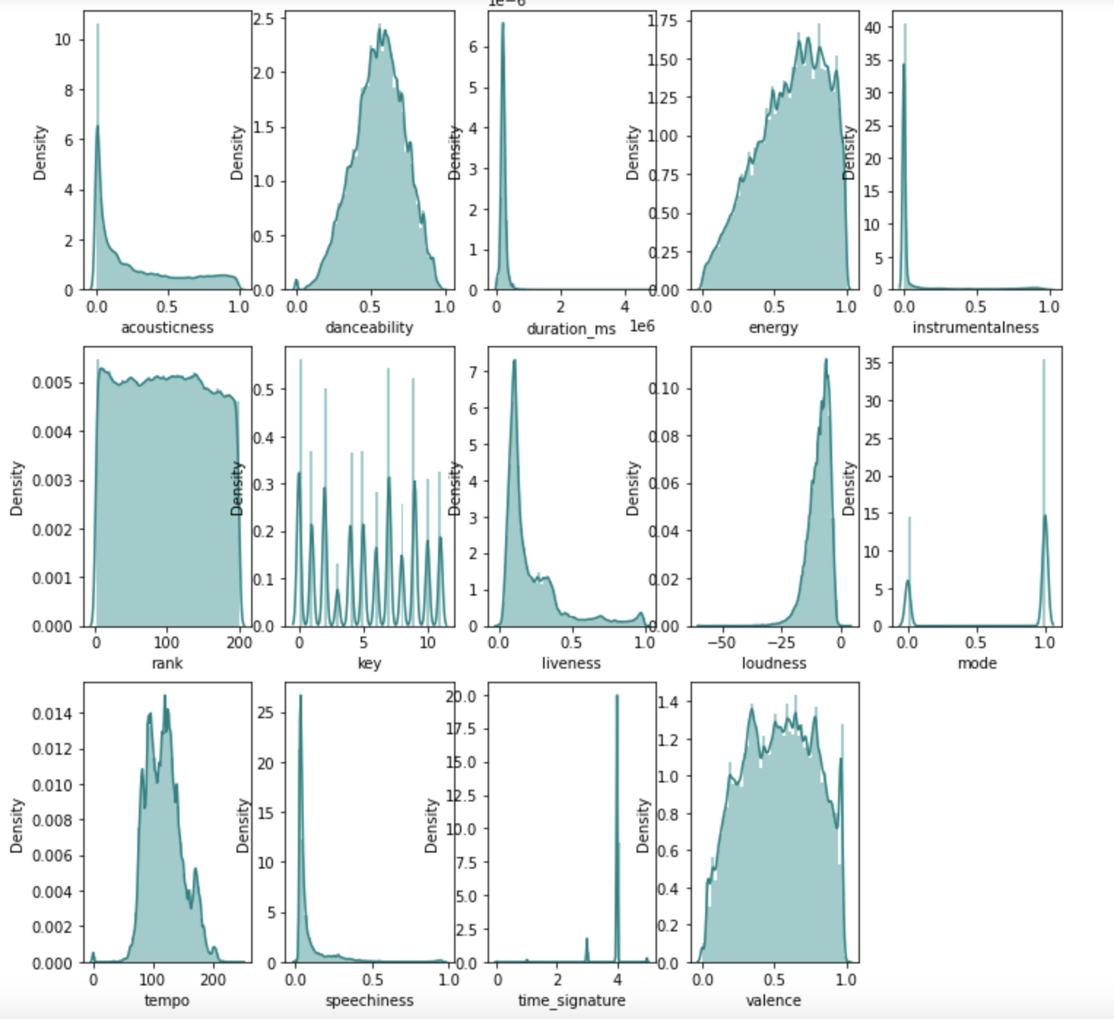
Brief EDA for Acoustic Features

Slide 6
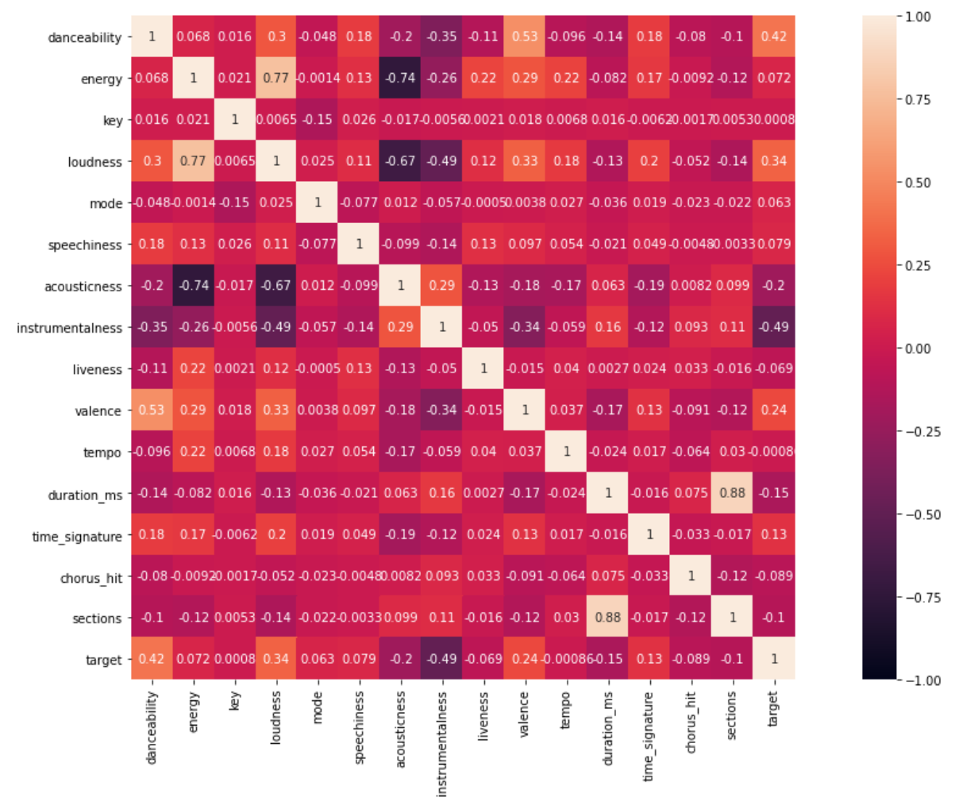
Heatmap showing correlation between columns

Slide 7
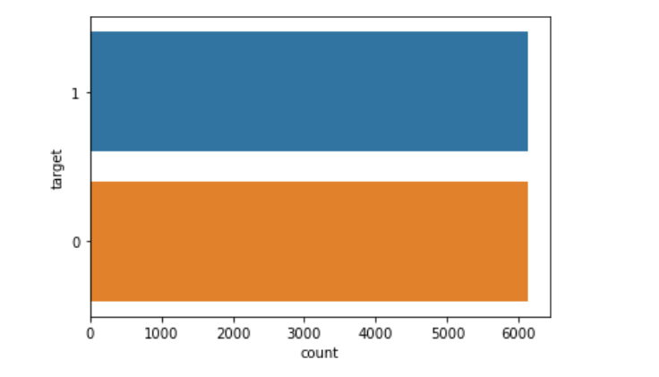
Count of the hits and flops

Slide 8
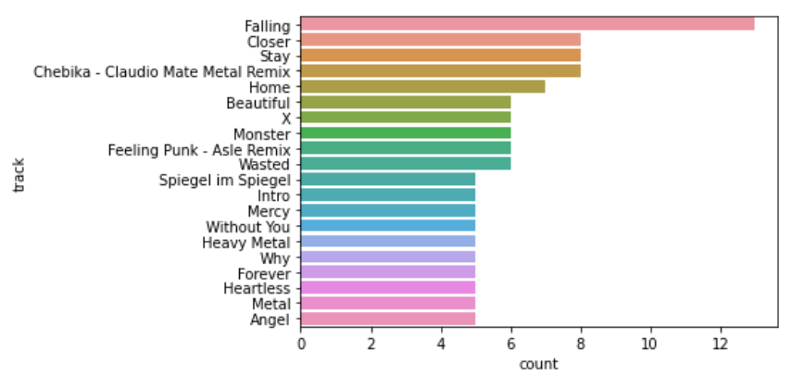
Count for the top tracks
Notes:
Falling track seems to have the highest number of track counts and a lot of the tracks are duplicates.

Slide 9
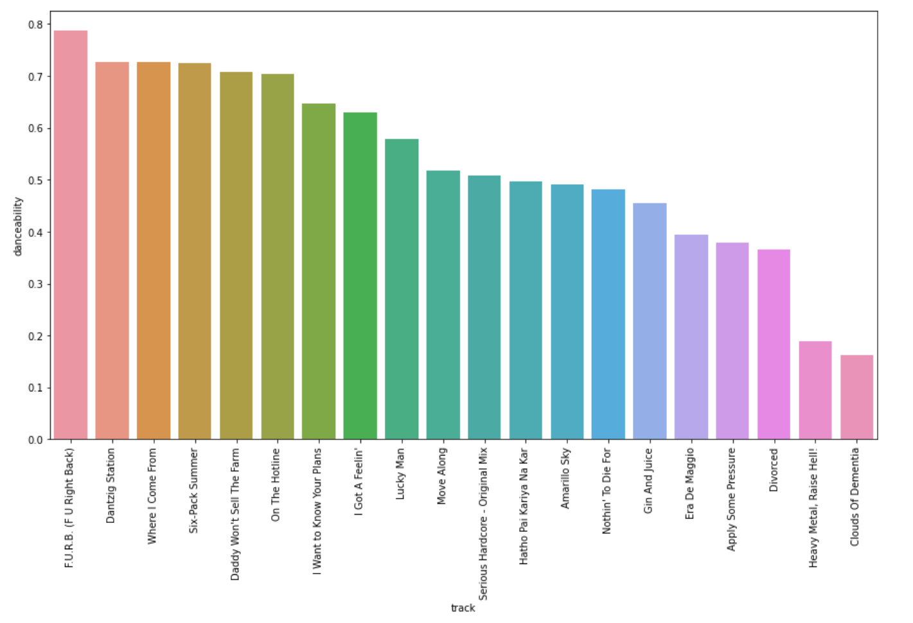
Top 20 tracks with highest danceability value
Notes:
Danceability shows how suitable a track is based on the combination of tempo (only actual column - beats/min), rhythm, stability, beat strength and overall regularity. 0 means least danceable and 1 means completely danceable. So, it seems the highest is closest to 0.8. Danceability had highest positive correlation with the target.

Slide 10
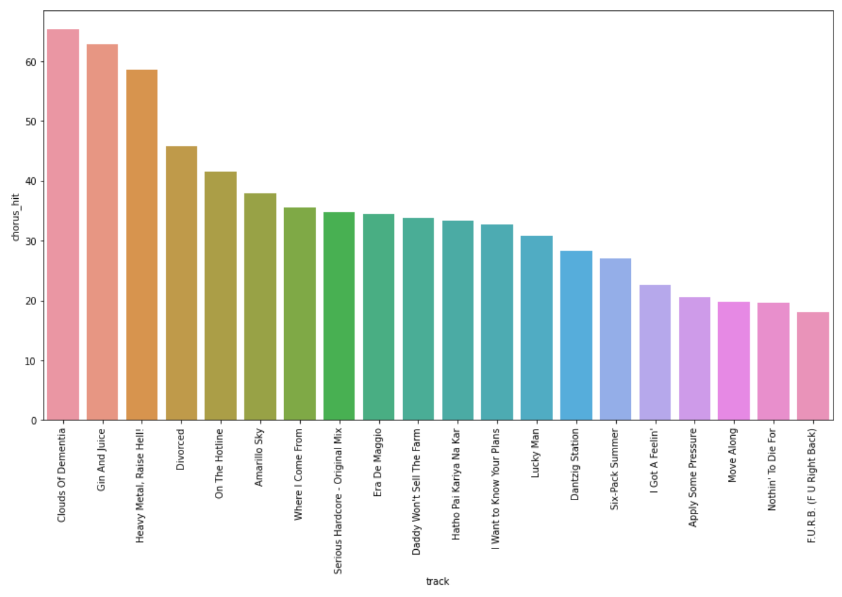
Top 20 tracks with longest time before chorus
Notes:
Chorus hit is the best estimate of when the chorus would start the time stamp. The Y axis is the timestamp. Longest time before chorus starts.

Slide 11
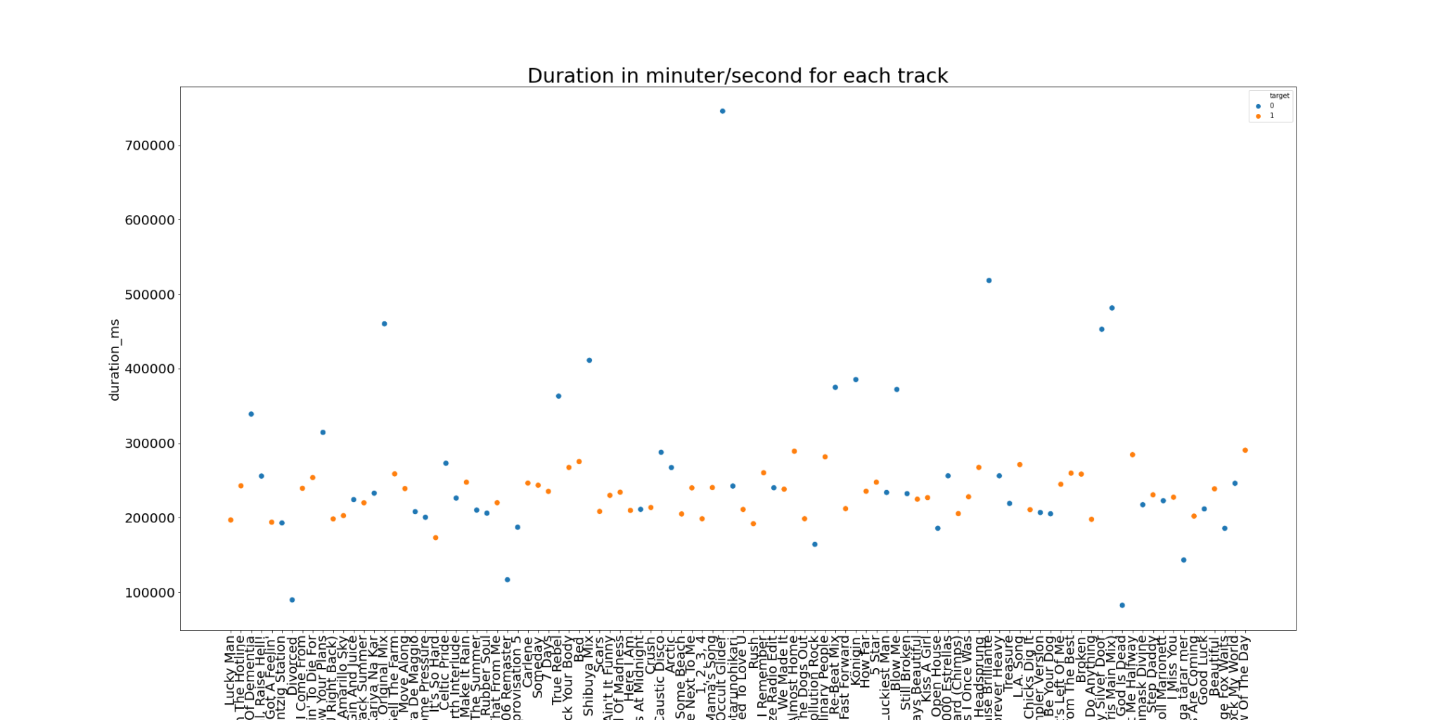
Duration in m/s for each track
Notes:
It seems the tracks which have durations of between 200M m/s to 300M m/s seem to be hits and some of the ones that exceed the limit seem to not be hits.

Slide 12
Next Steps
Bring in lyrics for each song
Continue further EDA
Feature engineering
Design predictive models

